Slide 1


BlockFinance AG ECO
BlockFinance ECO
Liechtenstein-based company that specializes in developing secure Blockchain and IT-Security solutions
We can access a large international competence team from its company group, with more than 15 years of experience in Blockchain and IT Security.
Hacking Challenge
Deep Dive

Slide 2
Challenge 1
Tools & Infrastructure

Slide 3


ECO is
Crypto
WorkSpace
CryptoWorkspace
Each team sends an email to cryptoworkspace@blockfinance-eco.li
Login on https://cryptoworkspace.li/
Enter email, login code and password of your choice.
Go to the Admin Panel on the left and subscribe to the Free Package.

Slide 4
ECO is
Crypto
WorkSpace
Technical
Specification requirements
Minimum of 800 GB of free HD space,
Preferably 1 TB.

Slide 5
ECO is
Crypto
WorkSpace
Laptops
For teams without the necessary Tech Specs
10 Available
At the stand

Slide 6
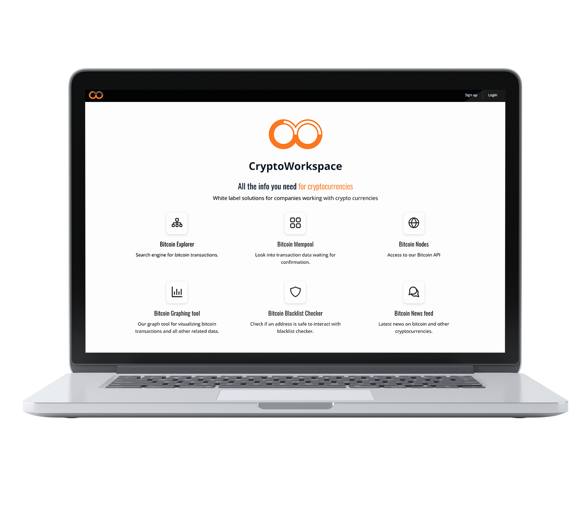
Crypto WorkSpace
Services
Service
Fee
Setup
Fee
Support
Level
Training
BIP 85
Contact
Information
A bitcoin wallet structure using BIP-85 for your company.
Multiple BIP39 seeds for accounting, salaries, fundraising, etc.
A company vault wallet that will be used to fund the company derived from the BIP-85 seed.
cryptoworkspace@blockfinance-eco.li
+423 340 08 08
HAUS RHI
Rhigass 1
9487 Gamprin-Bendern
Liechtenstein

Slide 7
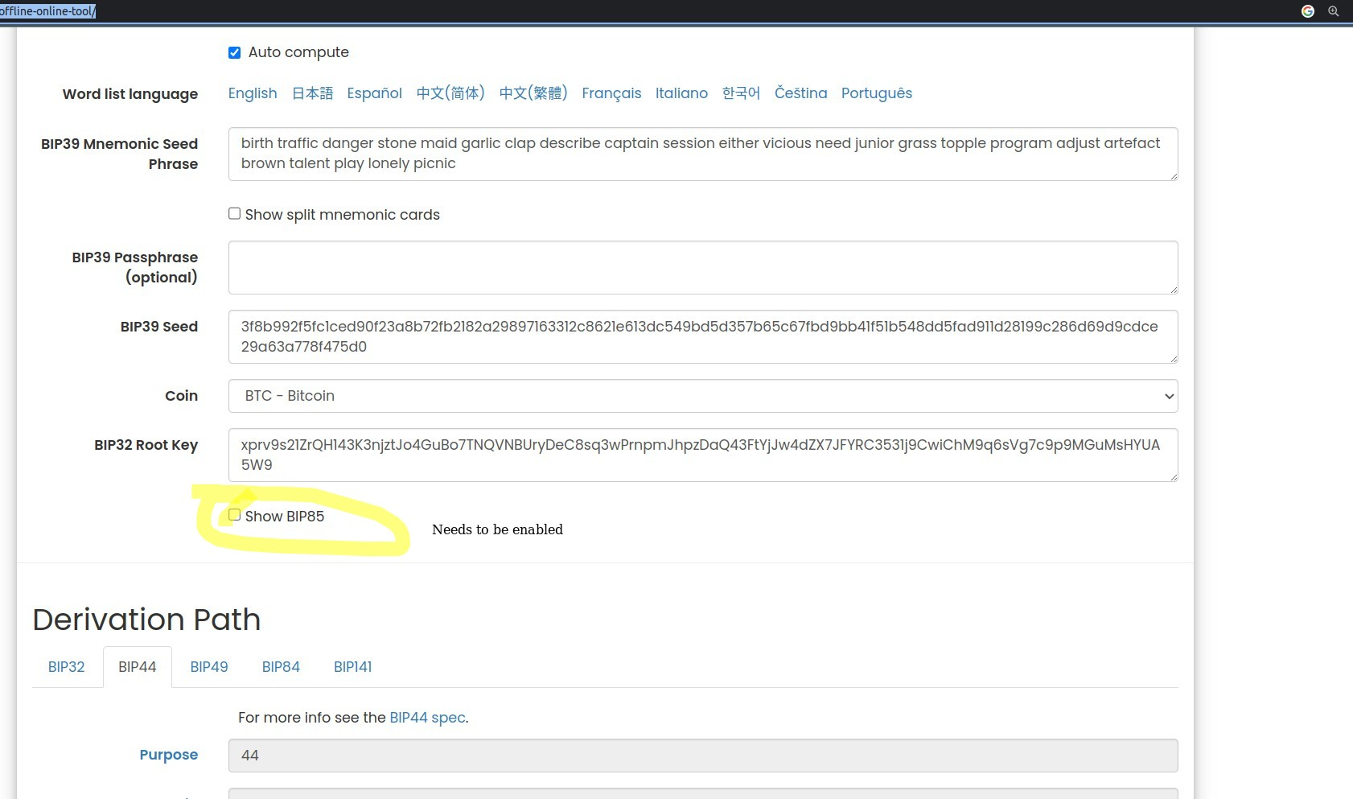
Crypto WorkSpace
Services
Service
Fee
Setup
Fee
Support
Level
Training
BIP 85
Contact
Information
cryptoworkspace@blockfinance-eco.li
+423 340 08 08
HAUS RHI
Rhigass 1
9487 Gamprin-Bendern
Liechtenstein

Slide 8
Crypto WorkSpace
Services
Service
Fee
Setup
Fee
Support
Level
Training
BIP 85
Helpful Links
Contact
Information
https://github.com/bitcoin/bips/blob/master/bip-0085.mediawiki
https://getcoinplate.com/bip39-seed-phrase-mnemonics-generator-offline-online-tool/
cryptoworkspace@blockfinance-eco.li
+423 340 08 08
HAUS RHI
Rhigass 1
9487 Gamprin-Bendern
Liechtenstein

Slide 9
Bitcoin Value Assert
Helpful Links
https://github.com/Blockfinance-ECO/Bitcoin-Value-Assert
Watch a video on how to use it: https://www.youtube.com/watch?v=Gyy8i1_MRIs

Slide 10
Bitcoin Node
Helpful Links
https://bitcoin.org/en/full-node#initial-block-downloadibd
https://bitcoin.org/en/download
https://jlopp.github.io/bitcoin-core-config-generator/
https://developer.bitcoin.org/reference/rpc/
https://bitcoindev.network/bitcoin-script-101/

Slide 11
ECO is
Crypto
WorkSpace
General Bitcoin Resources
Helpful Links
https://github.com/bitcoinbook/bitcoinbook

Slide 12
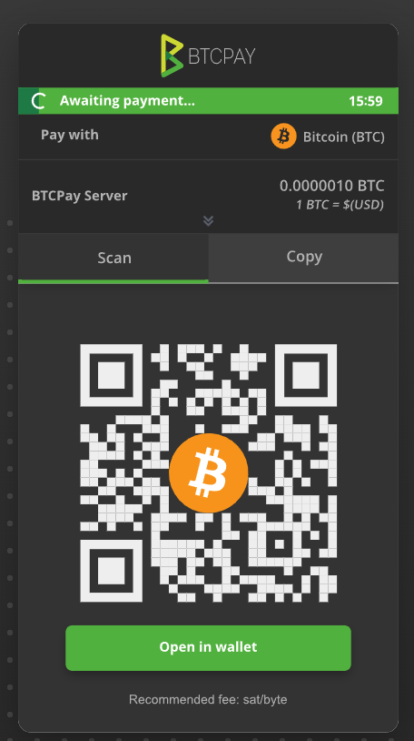
Bitcoin Payment Server
Helpful Links
https://btcpayserver.org/

Slide 13
Crypto WorkSpace
Services
Service
Fee
Setup
Fee
Support
Level
Training
Bitcoin Infrastructure
Connecting to Network Box
Contact
Information
Cable
Just plug in the network cable to your Laptop and you will get an IP address via DHCP.
Via WiFi
2G-Wifi
SSID: BlockfinanceECO-CrypotWorkspace
Password: ask operator
5G-Wifo
SSID: BlockfinanceECO-CrypotWorkspace
Password: ask operator
cryptoworkspace@blockfinance-eco.li
+423 340 08 08
HAUS RHI
Rhigass 1
9487 Gamprin-Bendern
Liechtenstein

Slide 14
Crypto WorkSpace
Services
Service
Fee
Setup
Fee
Support
Level
Training
Bitcoin Infrastructure
Internal IP Addresses
Contact
Information
NAS01
To get all your needed Blockchain files visit NAS01 at:
https://10.20.20.10/ or
https://nas01.bfeco.local/
User: bfeco
Pass: bfeco123
Domain: WORKGROUP
cryptoworkspace@blockfinance-eco.li
+423 340 08 08
HAUS RHI
Rhigass 1
9487 Gamprin-Bendern
Liechtenstein

Slide 15
Crypto WorkSpace
Services
Service
Fee
Setup
Fee
Support
Level
Training
Bitcoin Infrastructure
Mount Via Console
Contact
Information
NFS
Multiple users
sudo apt install nfs-common
showmount -e 10.20.20.10 or showmount -e nas01.bfeco.local
Create a directory to mount a copy of bitcoin blockchain:
sudo mkdir /mnt/bitcoind
cryptoworkspace@blockfinance-eco.li
+423 340 08 08
HAUS RHI
Rhigass 1
9487 Gamprin-Bendern
Liechtenstein

Slide 16
Crypto WorkSpace
Services
Service
Fee
Setup
Fee
Support
Level
Training
Bitcoin Infrastructure
Mount Via Console
Contact
Information
Mount the NFS share with a copy of Bitcoin Blockchain
sudo mount -t nfs 10.20.20.10:/BFECO-Bitcoin /mnt/bitcoind
Now copy the Bitcoin blockchain to your local harddisk:
sudo rsync -av --info=progress2 /mnt/bitcoind/ /opt/
Next unmount the directory let other users sync as well:
sudo umount /mnt/bitcoind
cryptoworkspace@blockfinance-eco.li
+423 340 08 08
HAUS RHI
Rhigass 1
9487 Gamprin-Bendern
Liechtenstein

Slide 17
Crypto WorkSpace
Services
Service
Fee
Setup
Fee
Support
Level
Training
Bitcoin Infrastructure
Mount Via Console
Contact
Information
Once you did copy the blockchain you can then run bitcoin-qt or bitcoind:
sudo chown -R oem:oem /opt/* (run this once to correct file and folder access)
/opt/bitcoind/bin/bitcoin-qt -datadir=/opt/bitcoind/data/
cryptoworkspace@blockfinance-eco.li
+423 340 08 08
HAUS RHI
Rhigass 1
9487 Gamprin-Bendern
Liechtenstein

Slide 18
Challenge 2
All you gotta do in addition

Slide 19
ECO is
Crypto
WorkSpace
Task List
List to everything here:
https://github.com/START-Hack/BLOCKFINANCE-ECO_STARTHACK23/blob/main/README.md

Slide 20
Challenge 3
Be creative, add value surprise us.

Slide 21
You will be using real Bitcoin for the Challenge!

Slide 22

BlockFinance AG ECO
Liechtenstein-based company that specializes in developing secure Blockchain and IT-Security solutions
We can access a large international competence team from its company group, with more than 15 years of experience in Blockchain and IT Security.
HAVE FUN!

